Slide 1


Introduction to Digital Systems
EGR 326
Lecture_7
Dr. Nabeeh Kandalaft EGR226 Grand valley State University

Slide 2
Topics for today’s lecture
After today’s lecture you should be able to:
Configure the MSP432 clocks
Understand how to use the MSP432 timer peripherals, particularly the 16-bit timers
Create a pseudo analog signal using the MSP432 timera in pulse width modulation (PWM) mode
Dr. Nabeeh Kandalaft EGR226 Grand valley State University

Slide 3
MSP432 Clock System
Flexible clock sources & distribution:
5 clocks from 7 sources (2 external, 5 internal)
Selections suitable for high-speed & low-power operations
Wide range of operating frequency
10kHz to 48 MHz
Several ranged with dividers
Robust system:
Fail / safe mechanism for external sources (defaults to internal oscillator)
Dr. Nabeeh Kandalaft EGR226 Grand valley State University

Slide 4
MSP432 Clock System High and Low Frequency
Frequency |  | Oscillators | MCLK | SMCLK | HSMCLK | ACLK | BCLK | Comments
HF | 1-48 MHz | DCO | ✔ | ✔ | ✔ |  |  | Internal integrated digitally controlled oscillator.
 | 1-48 MHz | HFXT | ✔ | ✔ | ✔ |  |  | High frequency crystal. Frequency range is SW configurable.
 | 24MHz | MODOSC | ✔ | ✔ | ✔ |  |  | Internal osc. option for peripherals such as ADC
 | 5MHz | SYSOSC |  |  |  |  |  | Internal, direct clock for ADC failsafe for HFXT
LF | 32kHz | LFXT | ✔ | ✔ | ✔ | ✔ | ✔ | Low-frequency crystal oscillator
 | 32kHz 128kHz | REFO | ✔ | ✔ | ✔ | ✔ | ✔ | Internal low-frequency oscillator. Failsafe (32kHz) for LFXT
 | 10kHz | VLO | ✔ | ✔ | ✔ | ✔ |  | Internal ULP LF oscillator Clock selection for WDT
http://dev.ti.com/tirex/#/DevTool/MSP-EXP432P401R?link=MSPWare%2FDevices%2FMSP430%2FMSP432P4XX%2FMSP432P401R%2FTraining%2FDeep%20Dive%20Training%2FMSP432%20Deep%20Dive%20Training%20Lecture
Dr. Nabeeh Kandalaft EGR226 Grand valley State University

Slide 5
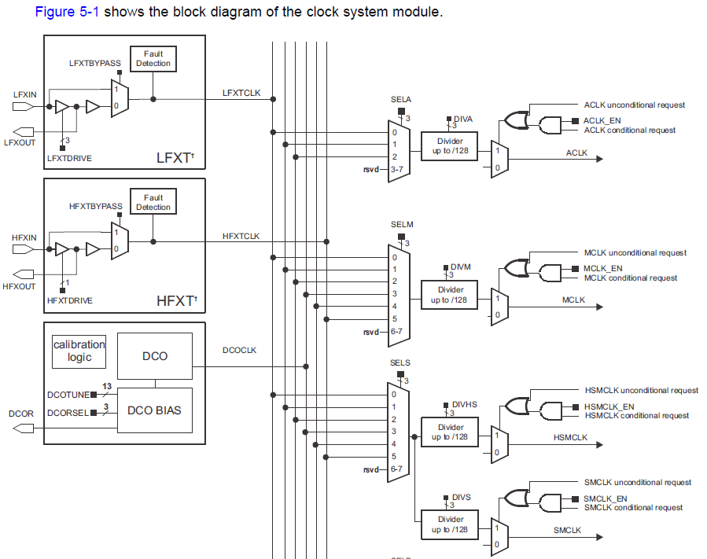
Excerpt from Figure 5-1 block diagram of clock system module showing some of the sources and selection for some of the clocks
MODOSC, REFO, VLO on bus (not shown)
From MSP432Pxx Family Technical Reference SLAU356D–March 2015–Revised July 2016 Clock System (CS)

Slide 6
MSP432 Clock System Default
After a system reset, the CS module default configuration is
For devices that have LFXT available:
LFXT crystal operation is selected as the resource for LFXTCLK
LFXTCLK is selected for ACLK and ACLK is undivided (DIVAx = 0)
LFXTCLK is selected for BCLK (no divider on BCLK)
The PSEL bits associated with the crystal pins must be set.
if a crystal fault is detected, the fault control logic immediately causes ACLK and BCLK to be sourced by REFOCLK
For devices that have HFXT available:
HFXIN and HFXOUT pins are set to general-purpose I/Os and HFXT is disabled.
DCOCLK is selected for MCLK, HSMCLK, and SMCLK and each system clock is undivided (DIVMx = DIVSx = DIVHSx = 0).
All settings registers are locked, must be unlocked to configure
Dr. Nabeeh Kandalaft EGR226 Grand valley State University

Slide 7
MSP432 Clock System
Why so many clocks?
Power dissipated is linearly related to clock speed
Each peripheral device should be run at its lowest feasible clock speed (battery operation)
Some may need high clock rate (e.g., ADC for high sample rate, graphics module for animated display)
Some may not (e.g., watchdog timer)
MSP432 can use a 48 MHz crystal for accurate max clock speed and 32.785 KHz for accurate time keeping in the RTC module
Dr. Nabeeh Kandalaft EGR226 Grand valley State University

Slide 8
MSP432 Clock System
/*--------------------- Configuration Instructions ----------------------------
1. If you prefer to halt the Watchdog Timer, set __HALT_WDT to 1:
#define __HALT_WDT 1
2. Insert your desired CPU frequency in Hz at:
#define __SYSTEM_CLOCK 12000000
3. If you prefer the DC-DC power regulator (more efficient at higher
frequencies), set the __REGULATOR to 1:
#define __REGULATOR 1
*---------------------------------------------------------------------------*/
/*--------------------- Watchdog Timer Configuration ------------------------*/
// Halt the Watchdog Timer
// <0> Do not halt the WDT
// <1> Halt the WDT
#define __HALT_WDT 1
/*--------------------- CPU Frequency Configuration -------------------------*/
// CPU Frequency
// <1500000> 1.5 MHz
// <3000000> 3 MHz
// <12000000> 12 MHz
// <24000000> 24 MHz
// <48000000> 48 MHz
#define __SYSTEM_CLOCK 3000000
@file system_msp432p401r.c
Dr. Nabeeh Kandalaft EGR226 Grand valley State University

Slide 9
MSP432 Clock System
You can set the DCO clock frequency in your code:
A structure “CS” is setup to allow access to all clock registers.
/* Configure DCO to 48MHz, ensure MCLK uses DCO as source*/
CS->KEY = CS_KEY_VAL ; // Unlock CS module for register access
CS->CTL0 = 0; // Reset tuning parameters
CS->CTL0 = CS_CTL0_DCORSEL_5; // Set DCO to 48MHz
/* Select MCLK = DCO, no divider */
CS->CTL1 = CS->CTL1 & ~(CS_CTL1_SELM_MASK |
CS_CTL1_DIVM_MASK) |
CS_CTL1_SELM_3;
CS->KEY = 0; // Lock CS from unintended accesses
Dr. Nabeeh Kandalaft EGR226 Grand valley State University

Slide 10
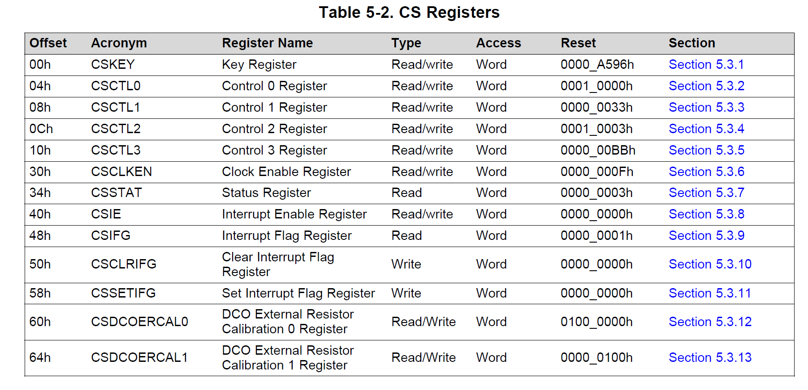
MSP432 Clock System
Reference Manual page 319
Dr. Nabeeh Kandalaft EGR226 Grand valley State University

Slide 11
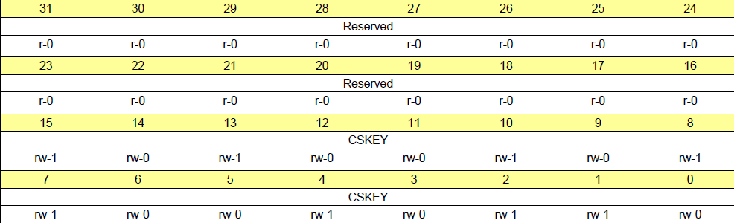
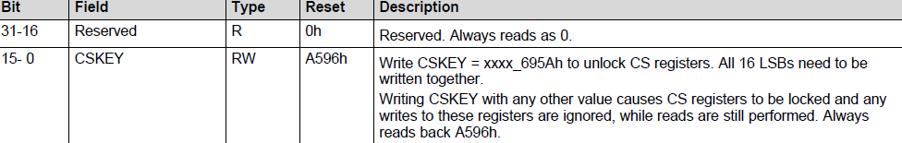
MSP432 Clock System
CSKEY Register (offset = 00h) [reset = 0000_A596h]
Clock System Key Register
Figure 5-5. CSKEY Register
#define CS_KEY_VAL ((uint32_t)0x0000695A) /*!< CS control key value */
Reference Manual page 319
Dr. Nabeeh Kandalaft EGR226 Grand valley State University

Slide 12
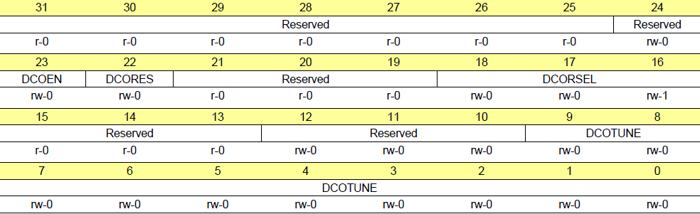
MSP432 Clock System
CSCTL0 Register (offset = 04h) [reset = 0001_0000h]
Clock System Control 0 Register
Figure 5-6. CSCTL0 Register
Reference Manual page 320
Dr. Nabeeh Kandalaft EGR226 Grand valley State University

Slide 13
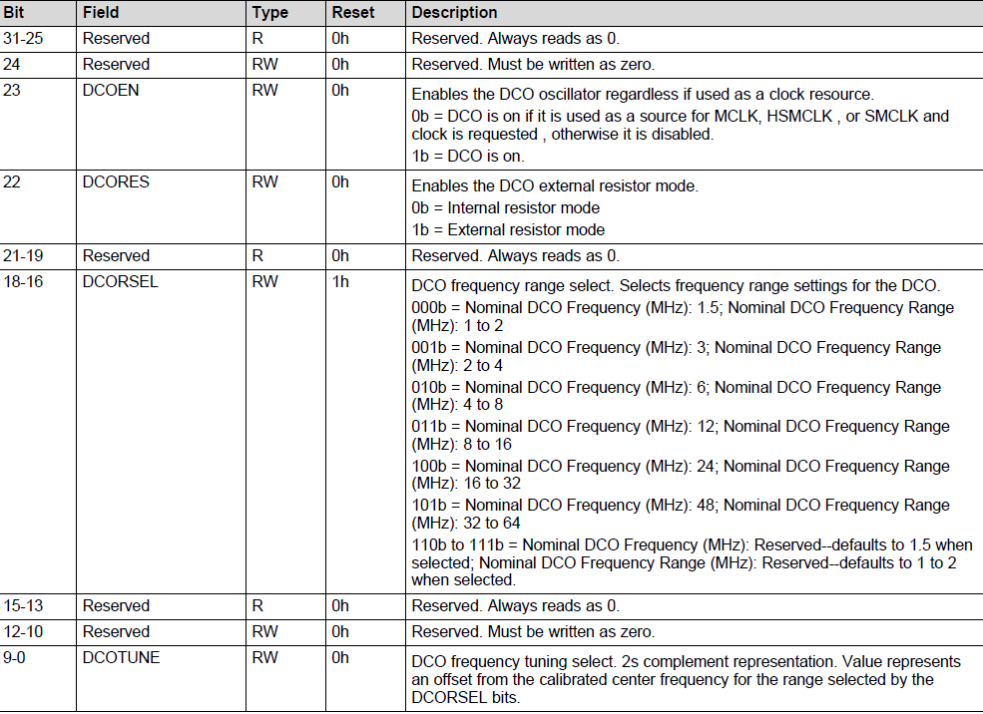
MSP432 Clock System
Table 5-4. CSCTL0 Register Description
Reference Manual page 320
Dr. Nabeeh Kandalaft EGR226 Grand valley State University

Slide 14
MSP432 Clock System
You paid for a 48 MHz external crystal, why not use it?
Navigate the Resource Explorer to the MSP432Ware/Devices/MSP432P4xx/Code Examples/ directory.
Msp432p401x_cs_09.C to connect the external crystal to your controller
PJ->SEL0 |= BIT2 | BIT3; // Configure PJ.2/3 for HFXT function
PJ->SEL1 &= ~(BIT2 | BIT3);
CS->KEY = CS_KEY_VAL ; // Unlock CS module for register access
CS->CTL2 |= CS_CTL2_HFXT_EN | CS_CTL2_HFXTFREQ_6 | CS_CTL2_HFXTDRIVE;
while(CS->IFG & CS_IFG_HFXTIFG)
CS->CLRIFG |= CS_CLRIFG_CLR_HFXTIFG;
/* Select MCLK & HSMCLK = HFXT, no divider */
CS->CTL1 = CS->CTL1 & ~(CS_CTL1_SELM_MASK | CS_CTL1_DIVM_MASK | CS_CTL1_SELS_MASK | CS_CTL1_DIVHS_MASK) |
CS_CTL1_SELM__HFXTCLK | CS_CTL1_SELS__HFXTCLK;
CS->KEY = 0; // Lock CS module from unintended accesses
Dr. Nabeeh Kandalaft EGR226 Grand valley State University

Slide 15
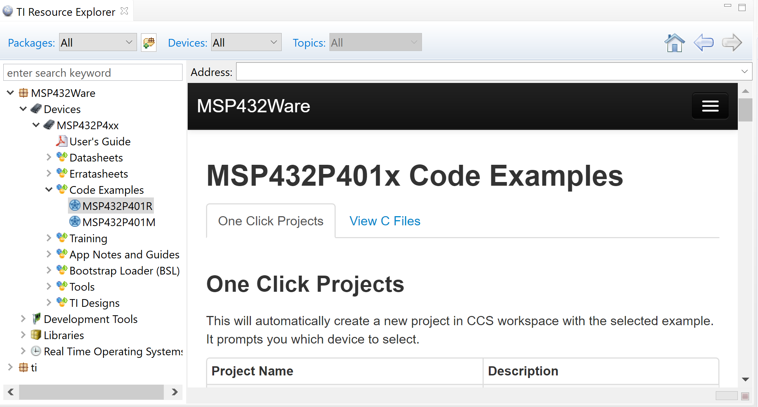
Code Composer Example Code:
Dr. Nabeeh Kandalaft EGR226 Grand valley State University

Slide 16
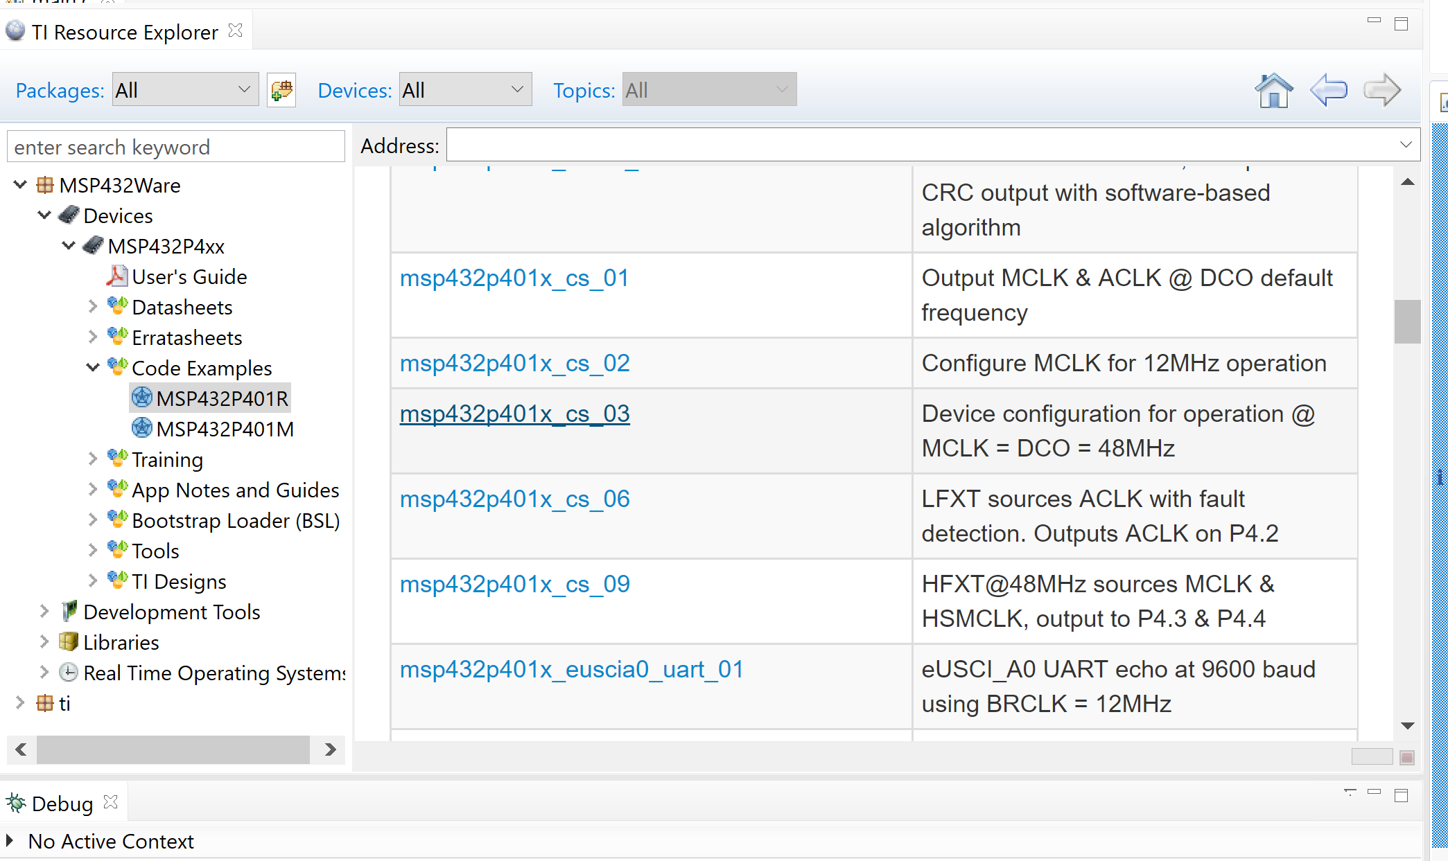
Code Composer Example Code:
Dr. Nabeeh Kandalaft EGR226 Grand valley State University

Slide 17
Embedded system architecture
Inputs
Processing and Control
Outputs
analog
sensors
A/D
converter
D/A
converter
analog
actuators
power
supply
display
micro
controller
digital
inputs
digital
actuators
inter-process
communication
memory
timers
Dr. Nabeeh Kandalaft EGR226 Grand valley State University

Slide 18
Creating an analog output on a microcontroller using
pulse width modulation (PWM)
To adjust the energy delivered to a component, vary its voltage or current.
For example,
DC motors turn faster when more voltage is applied.
LED’s shine brighter when more current flows through them.
A microcontroller can use a Digital to Analog Converter (DAC) followed by a filter to create an analog time varying voltage
The MSP432 has no DAC peripheral, but, can create an equivalent through pulse-width modulation (PWM)
The effective average energy delivered to a component can be generated using PWM on a microcontroller output pin.
Dr. Nabeeh Kandalaft EGR226 Grand valley State University

Slide 19
Pulse-Width Modulation
A PWM waveform is a digital periodic waveform.
The signal’s period T, the “ON-time” (fraction of T during which the signal is high), and “OFF-time” (fraction of T during which the signal is low) determine the pulse width and the modulation period.
period
T
T_{ON}
Vmax
T_{OFF}
0
t
The ratio of ON-time to the total period is known as the
duty cycle of the PWM waveform.
Dr. Nabeeh Kandalaft EGR226 Grand valley State University

Slide 20
Timers | Overview
Timer | Instances | # of Bits | Lowest Operating mode | Interval | PWM | Main/Other Function
Timer_A | 4 | 16 | LPM0, LPM0_LF | ✔✔ | ✔ | Capture, Compare
Timer32 | 2 | 32 | LPM0, LPM0_LF | ✔✔
SysTick | 1 | 24 | LPM0, LPM0_LF | ✔✔
RTC | 1 | 32* | LPM3, LPM3.5 | ✔ |  | RTC
WDT | 1 |  | LPM3, LPM3.5 | ✔ |  | WDT
RTC & WDT: only have a few selection of pre-set intervals
Timer_A, Timer32, SysTick: configurable intervals with 16/32/24-bit granularity
Today we’ll focus on the 16 bit Timer A
Timer A is a sophisticated timer that can be used for pulse width modulation (PWM) to generate a pseudo-analog signal
Timer A can also be used to count events and the time between them
Dr. Nabeeh Kandalaft EGR226 Grand valley State University
Notes:
So first off with timers, there are quite a few timer resources available on MSP432. Each with different feature sets to fit different requirements and different types of applications. Starting off with Timer A, Timer A is a 16 bit timer available on many existing MSP430 devices; it is also the most flexible timer, essentially a Swiss Army knife of timer because it can be used in many different use cases. So each Timer A module comes with five capture and compares channels. Each of the channels can be configured in many different counting modes, such as continuous counting mode, up down and it could also be used in different output modes such as toggle, set, reset and so on so forth. So all of these combinations that I just mentioned, you could leverage any of those across the five channels across the four instances, to essentially create and fulfil as many different timer scenarios as possible, such as creating an interval timer, driving multiple PWMs of either the same time base or different time bases, or even having multiple capture and compare input channels. Timer A can also be sourced by any high speed as well as low speed clock sources. Moving on to the next two timers are Timer 32 and SysTick, these two are the two standard on timer modules. With Timer 32 as the name suggest, it is a 32-bit timer and there are two instances of Timer 32 on MSP432 and they can be cascaded together. So you could use the Timer 32 to essentially create any interval with a resolution of up to 32bit. Similarly, SysTick could either be used to count the number of CPU ticks or it can also be used to create an interval of up to 24 bit of resolution. So both Timer 32 and SysTick must be sourced from a high speed clock source typically there is an MCLK. The MSP432 also includes two low frequency timers, the Real Time Clock as well as the Watchdog Timer. Both of these timers can use a 32KHz clock source and they can operate all the way down to LPM3.3 and LPM 3.5 power modes. In addition to their primary functions as RTC and Watchdog, they can also be used as interval timers, which can be really useful for the device to wake up periodically from LPM3. So all of these timers that we have covered here they are all capable of generating interrupt based on their primary functions, whether that be PWM, capture compare, RTC or Watchdog, as well as they can also generate an interrupt as a generic interval timer.

Slide 21
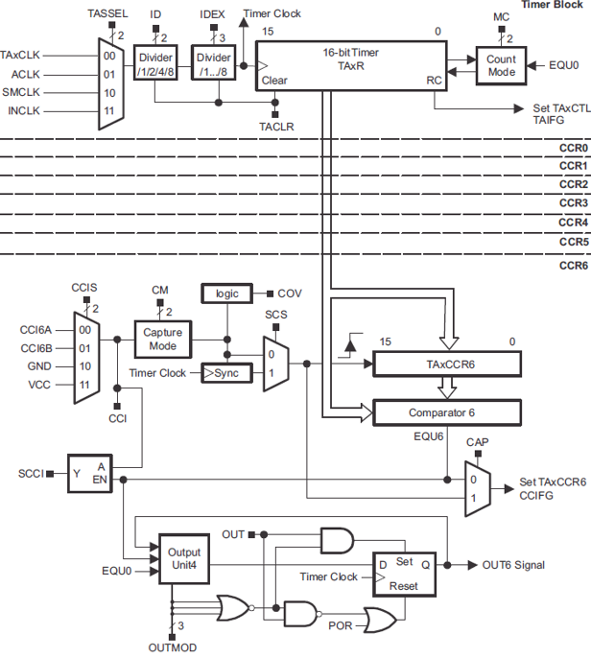
MSP432 16-bit Timer A
4 instances on MSP432P401R (TA0-3)
Each has 5 registers for capture/compare
4 clock sources
2 stages of clock divider
Counts clock pulses up, continuous, up/down
Counts to a value stored in register or rolls over to 0 at 2^{^16}
Also can count externally captured events
Can generate output waveforms (e.g., PWM) on port pins
Dr. Nabeeh Kandalaft EGR226 Grand valley State University

Slide 22
Timer Modes
The timer may be started or restarted by:
setting the mode in the MC bits > { 0 } and the clock source is active
when in Up or Up/down mode, writing a nonzero value to TAxCCR0 stops the count)
Timer_A Capture/Compare 0 Register
MC | Mode | Description
00 | Stop | The Timer is halted
01 | Up | The Timer repeatedly counts from zero to the value of TAxCCR0
10 | Continuous | The Timer repeatedly counts from zero 0FFFFh
11 | Up/down | The Timer repeatedly counts from zero to the value of TAxCCR0 and back down to zero
0FFFFh
Continuous Mode
0h
Dr. Nabeeh Kandalaft EGR226 Grand valley State University

Slide 23
Timer Modes
If the count needs to be something other than 0xFFFF, use the Up mode
0FFFFh
TAxCCR0
Up mode
0FFFFh
TAxCCR0
Up/down mode
Or the Up/down mode (see the Technical Reference for details)
Dr. Nabeeh Kandalaft EGR226 Grand valley State University

Slide 24
Timer Output Modes
The OUTn signal is changed when the timer counts up to the TAxCCRn value and rolls from TAxCCR0 to zero, depending on the output mode.
0FFFFh
TAxCCR0
TAxCCR1
Output Mode 1: Set
Output Mode 2: Toggle / Reset
Output Mode 3: Reset / Set
Output Mode 4: Toggle
Output Mode 5: Reset
Output Mode 6: Toggle / Set
Output Mode 7: Reset / Set
EQU0
TAIFG
EQU1
EQU0
TAIFG
EQU1
EQU0
TAIFG
EQU1
EQU0
TAIFG
Interrupt Events
Dr. Nabeeh Kandalaft EGR226 Grand valley State University

Slide 25
Timer Pulse-Width Modulation Mode
Set timer to count in Up mode
Set period count in CCR0
Set duty cycle count in CCR1
Set output signal mode to reset/set
Output can be stopped by writing 0 to CCR0
0FFFFh
TAxCCR0
TAxCCR1
Output Mode 7: Reset / Set
EQU1
EQU0
TAIFG
EQU1
EQU0
TAIFG
EQU0
TAIFG
Dr. Nabeeh Kandalaft EGR226 Grand valley State University

Slide 26
TIMER A Pin selection
Timer A | Port Pin | Timer A | Port Pin | Timer A | Port Pin | Timer A | Port Pin
TA0.0 | P7.3 | TA1.0 | P8.0 | TA2.0 | P8.1 | TA3.0 | P10.4
TA0.1 | P2.4 | TA1.1 | P7.7 | TA2.1 | P5.6 | TA3.1 | P10.5
TA0.2 | P2.5 | TA1.2 | P7.6 | TA2.2 | P5.7 | TA3.2
TA0.3 | P2.6 | TA1.3 | P7.5 | TA2.3 | P6.6 | TA3.3
TA0.4 | P2.7 | TA1.4 | P7.4 | TA2.4 | P6.7 | TA3.4

Slide 27
C
o
r
t
e
x
M
4
S
y
s
t
i
c
k
S
y
s
t
e
m
B
u
s
I
n
t
e
r
f
a
c
e
N
V
I
C
G
P
I
O
P
o
r
t
1
G
P
I
O
P
o
r
t
6
P
1
.
7
/
U
C
B
0
S
C
L
T
i
m
e
r
A
P
6
.
7
/
T
A
2
.
4
/
/
U
C
B
3
S
C
L
MSP432 Architecture
P
1
.
6
/
U
C
B
0
S
D
A
P
6
.
6
/
T
A
2
.
3
/
U
C
B
3
S
D
A
P
1
.
5
/
U
C
B
0
C
L
K
P
6
.
5
/
U
C
B
1
S
C
L
P
P
1
.
4
/
U
C
B
0
S
T
E
e
U
S
C
I
e
U
S
C
I
P
6
.
4
/
U
C
B
1
S
D
A
P
1
.
3
/
U
C
A
0
T
X
D
P
6
.
3
/
U
C
B
1
C
L
K
P
1
.
2
/
U
C
A
0
R
X
D
P
6
.
2
/
U
C
B
1
S
T
E
1
.
1
/
U
C
A
0
C
L
K
A
D
C
1
4
P
6
.
1
/
A
1
4
P
1
.
0
/
U
C
A
0
S
T
E
P
6
.
0
/
A
1
5
G
P
I
O
P
o
r
t
2
G
P
I
O
P
o
r
t
7
P
2
.
7
/
T
A
0
.
4
P
7
.
7
/
T
A
1
.
1
/
C
0
.
2
P
2
.
6
/
T
A
0
.
3
T
i
m
e
r
A
P
7
.
6
/
T
A
1
.
2
/
C
0
.
3
P
2
.
5
/
T
A
0
.
2
P
7
.
5
/
T
A
1
.
3
/
C
0
.
4
P
2
.
3
/
P
2
.
4
/
T
A
0
.
1
T
i
m
e
r
A
P
7
.
4
/
T
A
1
.
4
/
C
0
.
5
P
2
.
2
/
U
C
A
1
T
X
D
P
7
.
3
/
T
A
0
.
0
General-Purpose I/O (GPIO):
78 pins
10 ports
P
2
.
1
U
C
A
1
R
X
D
e
U
S
C
I
P
7
.
2
/
C
1
O
U
T
/
T
A
1
C
L
K
P
2
.
/
U
C
A
1
C
L
K
P
7
.
1
/
C
0
O
U
T
/
T
A
0
C
L
K
0
/
U
C
A
1
S
T
E
P
7
.
0
/
S
M
C
L
K
/
D
M
A
E
0
G
P
I
O
P
o
r
t
3
G
P
I
O
P
o
r
t
8
P
3
.
7
/
U
C
B
2
S
C
L
P
8
.
7
/
A
1
8
P
3
.
6
/
U
C
B
2
S
D
A
A
D
C
1
4
P
8
.
6
/
A
1
9
P
3
.
5
/
U
C
B
2
C
L
K
P
8
.
5
/
A
2
0
P
P
3
.
4
/
U
C
B
2
S
T
E
e
U
S
C
I
P
8
.
4
/
A
2
1
3
.
3
/
U
C
A
2
T
X
D
P
8
.
3
/
T
A
3
C
L
K
P
3
.
2
/
U
C
A
2
R
X
D
T
i
m
e
r
A
P
8
.
2
/
T
A
3
.
2
/
A
/
A
2
2
Pins are multiplexed between
std I/O and peripherals
P
3
.
1
/
U
C
A
2
C
L
K
P
8
.
1
/
U
C
B
3
C
2
3
P
3
.
0
/
U
C
A
2
S
T
E
e
U
S
C
I
P
8
.
0
/
U
C
B
3
S
L
K
/
T
A
2
.
0
T
E
/
T
A
1
.
0
G
P
I
O
P
o
r
t
4
G
P
I
O
P
o
r
t
9
P
4
.
7
/
A
6
P
9
.
7
/
U
C
A
3
T
X
D
P
4
.
6
/
A
7
e
U
S
C
I
P
9
.
6
/
U
C
A
3
R
X
D
Only 67 pins are available
P
4
.
5
/
A
8
P
9
.
5
/
U
C
A
3
C
L
K
P
4
.
3
/
R
T
C
P
4
.
4
/
A
9
A
D
C
1
4
P
9
.
4
/
U
C
A
3
S
T
E
P
4
.
2
/
T
A
2
C
L
K
/
A
1
0
T
i
m
e
r
A
P
9
.
3
/
T
A
3
.
4
C
L
K
/
A
1
1
P
9
.
2
/
T
A
3
.
3
P
4
.
1
/
A
1
2
A
D
C
1
4
P
9
.
1
/
A
1
6
4
.
0
/
A
1
3
P
9
.
0
/
A
1
7
G
P
I
O
P
o
r
t
5
G
P
I
O
P
o
r
t
1
0
P
5
.
7
/
T
A
2
.
2
T
i
m
e
P
T
i
m
e
r
A
P
1
0
.
5
/
T
A
3
.
1
/
C
0
.
6
P
5
.
6
/
T
A
2
.
1
r
A
P
1
0
.
4
/
T
A
3
.
0
/
C
0
.
7
P
5
.
5
/
A
0
P
1
0
.
3
/
U
C
B
3
S
C
L
P
5
.
4
/
A
1
e
U
S
C
I
P
1
0
.
2
/
U
C
B
3
S
D
A
P
5
.
3
/
A
2
A
D
C
1
4
P
1
0
.
1
/
U
C
B
3
C
L
K
P
5
.
2
/
A
3
P
1
0
.
0
/
U
C
B
3
S
T
E
P
5
.
1
/
A
4
T
i
m
e
r32
P
5
.
0
/
A
5
R
T
C
P1.0, P1.2, P1.3, P2.0, P2.1, P2.2, P3.1, & P3.4 are available on jumpers,
P1.1, P1.4, P8.1 are not)
P
e
r
i
p
h
e
r
a
l
B
u
s
Dr. Nabeeh Kandalaft EGR226 Grand valley State University

Slide 28
Partial Table of Alternate Pin Functions
Default Primary Secondary Tertiary
Pin | PxSEL1=0, PxSEL0=0 | PxSEL1=0, PxSEL0=1 | PxSEL1=1, PxSEL0=0 | PxSEL1=1, PxSEL0=1
P1.0 | Port | UCA0STE
P1.1 | Port | UCA0CLK
P1.2 | Port | UCA0RXD/UCA0SOMI
P1.3 | Port | UCA0TXD/UCA0SIMO
P1.4 | Port | UCB0STE
P1.5 | Port | UCB0CLK
P1.6 | Port | UCB0SIMO/UCB0SDA
P1.7 | Port | UCB0SOMI/UCB0SCL
P2.0 | Port | UCA1STE
P2.1 | Port | UCA1CLK
P2.2 | Port | UCA1RXD/UCA1SOMI
P2.3 | Port | UCA1TXD/UCA1SIMO
P2.4 | Port | TA0.CCI1Aª / TA0.1^{b}
P2.5 | Port | TA0.CCI2Aª / TA0.2^{b}
P2.6 | Port | TA0.CCI3Aª / TA0.3^{b}
P2.7 | Port | TA0.CCI4Aª / TA0.4^{b}
P3.0 | Port | UCA2STE
P3.1 | Port | UCA2CLK
P3.2 | Port | UCA2RXD/UCA2SOMI
P3.3 | Port | UCA2TXD/UCA2SIMO
P3.4 | Port | UCB2STE
P3.5 | Port | UCB2CLK
P3.6 | Port | UCB2SIMO/UCB2SDA
P3.7 | Port | UCB2SOMI/UCB2SCL
P4.0 | Port |  |  | A13
P4.1 | Port |  |  | A12
P4.2 | Port | ACLK^{b} | TA2CLKª | A11
P4.3 | Port | MCLK^{b} | RTCCLK^{b} | A10
P4.4 | Port | HSMCLK^{b} | SVMHOUT^{b} | A9
P4.5 | Port |  |  | A8
P4.6 | Port |  |  | A7
P4.7 | Port |  |  | A6
MUX bits of
PxSEL0 & PxSEL1
General Purpose I/O
0
Table 4.1 in Valvano’s textbook
Primary Module Function
1
Secondary Module Function
2
Tertiary Module Function
3
Pin of Chip
SEL1 and SEL0 bits on the MSP432 specify alternate functions.
P1.2 and P1.3 are hardwired to the serial port to USB interface.
Dr. Nabeeh Kandalaft EGR226 Grand valley State University

Slide 29
Intro to Timing Using a Microcontroller
A common use for microcontrollers is to control physical devices with specific timings.
For example:
Flash an LED
Rotate a stepper
Wait 5 seconds for the user to press a key
To describe how timing works on the MSP432, most microcontroller datasheets specify all timing related information in
units of cycles.
A cycle is nothing more than one period of the microcontroller clock.
Dr. Nabeeh Kandalaft EGR226 Grand valley State University

Slide 30
Timer Pulse-Width Modulation Mode
// Configure GPIO for PWM output
P2->DIR |= BIT4; // P2.4 set TA0.1
P2->SEL0 |= BIT4;
P2->SEL1 &= ~(BIT4);
TIMER_A0->CCR[0] = 1000 - 1; // PWM Period (# cycles of clock)
TIMER_A0->CCTL[1] = 0b0000 0000 0111 0000 // CCR1 reset/set mode 7
TIMER_A0->CCR[1] = 500; // CCR1 PWM duty cycle in 10ths of percent
TIMER_A0->CTL = 0b0000 0010 0001 0100; // SMCLK, Up Mode, clear TAR to start
TIMER_A0->CTL = TASSEL_2 | MC_1 | TACLR // SMCLK, Up Mode, clear TAR to start
TIMER_A0->CTL = 0x0214; // SMCLK, Up Mode, clear TAR to start
Dr. Nabeeh Kandalaft EGR226 Grand valley State University

Slide 31
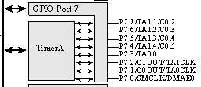
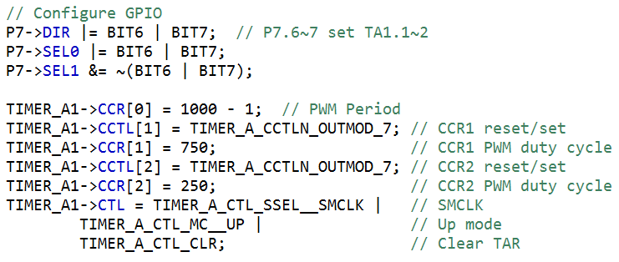
Timer Pulse-Width Modulation Mode
Example code from msp432p401x_ta1_16
After all parameters are set up, PWM output starts without further instructions until period or duty cycle need to be changed.
Counts for PWM period and duty cycle are based on SMCLK period.
Here, two separate PWM outputs are generated using one timer

Slide 32
Timers and PWM
In summary,
Clock signals
The MSP432 has several clock signals, some are based on external crystal oscillators, some on internal oscillators
Timers
The MSP432 has several useful timer peripherals that handle several timing and wave generation functions
PWM
Timer creates a pseudo-analog signal from a DC voltage that is converted to a
waveform of variable duty cycle
Can be used to control motor speed and LED light intensity
Dr. Nabeeh Kandalaft EGR226 Grand valley State University

